Slide 1
Artificial Intelligence
A Presentation By:
Daniel Breneman
Sean Cox
Robert McConnell
Brian Santo-Domingo

Slide 2
Overview
Definition
History
Economics
Philosophy
Ethics
Culture
Conclusion

Slide 3


Slide 4
Definition
blarg

Slide 5
History
First suggested by Alan Turing in the 1950's

Slide 6
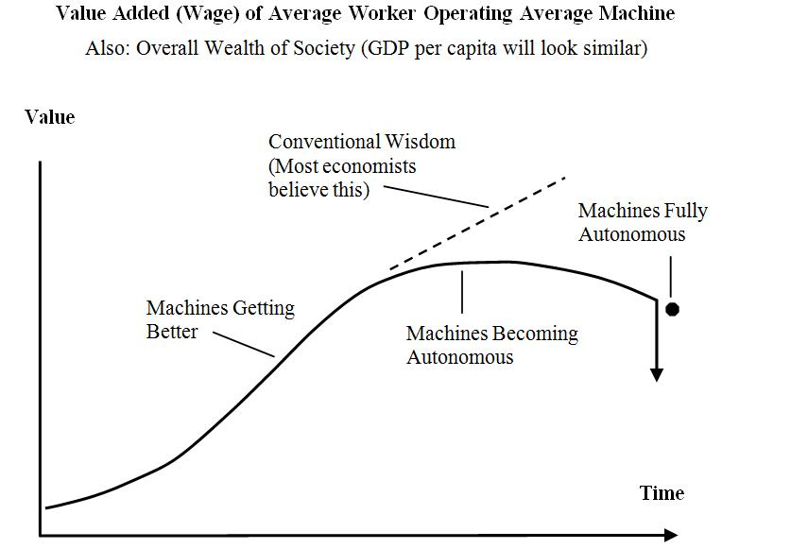
Economics
Automotive
Shipping
Agriculture
Notes:
Discussed the fact of lack of numbers in automotives, well aware it’s a hole in our research. Attempting to fix ASAP

Slide 7
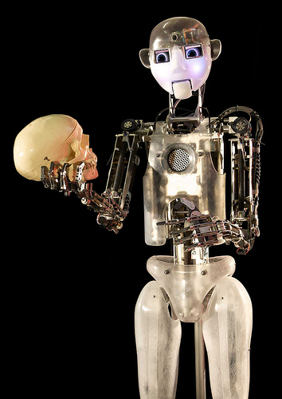
Philosophy
All about asking questions, and putting them in context
After asking questions, ask how they reflect upon yourself
Philosophy asks whether something is true.
Notes:
1st point; important questions in AI: can a machine feel? does it have a soul?
3rd point; exposit on difference between philosophy and ethics (ethics asks what it means *if* something is true)

Slide 8
Common Philosophical Questions
Can a machine feel emotions?
Does an AI have a soul?
Is an AI a person?
Notes:
Emotions question: Scherer definition of emotions (reaction to input in context of previous experiences and preferences) & reinforcement learning methods that mimic it.
Soul question: Much, much more abstract, reflect mostly on wobbly definition of a soul to begin with. Say that we're not even sure if *we* have a soul. Maybe mention idea of 'ghost in a shell' style constructs.
Person question: Related to soul question, but has more legal ramifications. Maybe talk a little about ttp://www.physorg.com/news185729677.html

Slide 9
Ethics
What is truly right? For humans? For robots?
Capable of so much, but to what extent?
Replacing humans with robots.

Slide 10
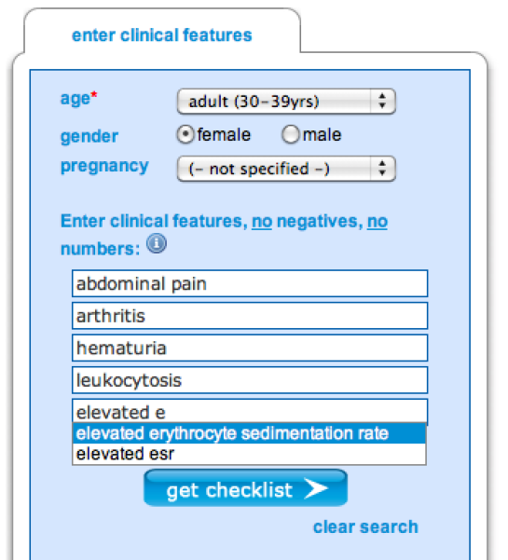
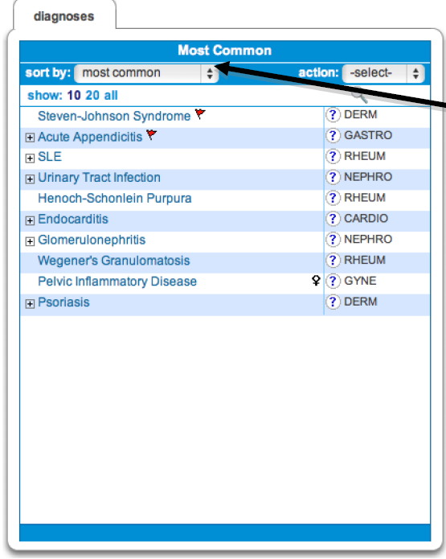
Culture
Idea of helping mankind with AI has been around since 1988
Intelligent knowledge gatherer systems such as Isabel help doctors make the tougher decisions in their career

Slide 11
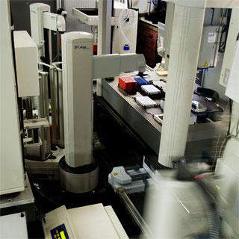
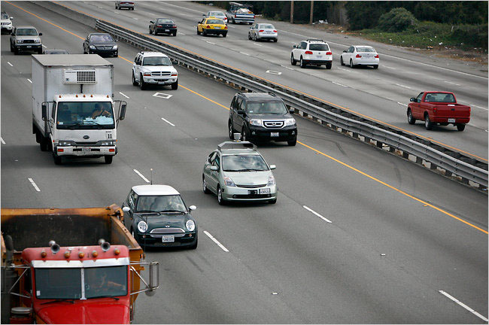
Culture (cont)
Adam utilizes robotics and a unique research intelligence to create, test and document biological experiments
DARPA has been funding the creation of self driving cars, some of which are in our very area.

Slide 13
Conclusion

Slide 14
References
Economics Image: http://warning.zoned.dk/

